Slide 1
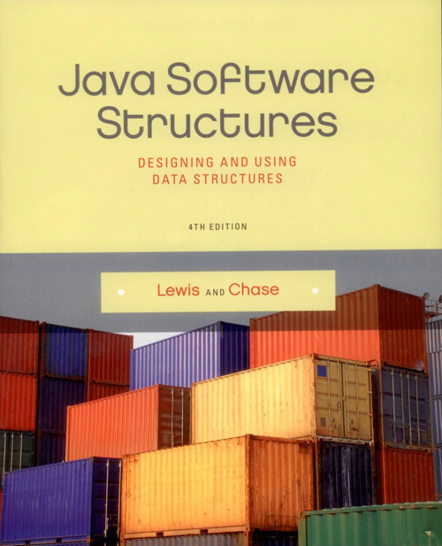
Chapter 8
Recursion

Slide 2
Chapter Scope
The concept of recursion
Recursive methods
Infinite recursion
When to use (and not use) recursion
Using recursion to solve problems
Solving a maze
Towers of Hanoi

Slide 3
Recursion
Recursion is a programming technique in which a method can call itself to fulfill its purpose
A recursive definition is one which uses the word or concept being defined in the definition itself
In some situations, a recursive definition can be an appropriate way to express a concept
Before applying recursion to programming, it is best to practice thinking recursively

Slide 4
Recursive Definitions
Consider the following list of numbers:
24, 88, 40, 37
Such a list can be defined recursively:
A LIST is a: number
or a: number comma LIST
That is, a LIST can be a number, or a number followed by a comma followed by a LIST
The concept of a LIST is used to define itself

Slide 5
Recursive Definitions
_{LIST:} _{number comma LIST}
_{24 , 88, 40, 37}
_{number comma LIST}
_{88 , 40, 37}
_{number comma LIST}
_{40 , 37}
_{number}
₃₇

Slide 6
Infinite Recursion
All recursive definitions must have a non-recursive part
If they don't, there is no way to terminate the recursive path
A definition without a non-recursive part causes infinite recursion
This problem is similar to an infinite loop -- with the definition itself causing the infinite “looping”
The non-recursive part is called the base case

Slide 7
Recursion in Math
Mathematical formulas are often expressed recursively
N!, for any positive integer N, is defined to be the product of all integers between 1 and N inclusive
This definition can be expressed recursively:
1! = 1
N! = N * (N-1)!
A factorial is defined in terms of another factorial until the base case of 1! is reached

Slide 8
Recursive Programming
A method in Java can invoke itself; if set up that way, it is called a recursive method
The code of a recursive method must handle both the base case and the recursive case
Each call sets up a new execution environment, with new parameters and new local variables
As always, when the method completes, control returns to the method that invoked it (which may be another instance of itself)

Slide 9
Recursive Programming
Consider the problem of computing the sum of all the integers between 1 and N, inclusive
If N is 5, the sum is
1 + 2 + 3 + 4 + 5
This problem can be expressed recursively as:
The sum of 1 to N is N plus the sum of 1 to N-1

Slide 10
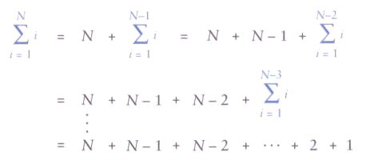
Recursive Programming
The sum of the integers between 1 and N:

Slide 11
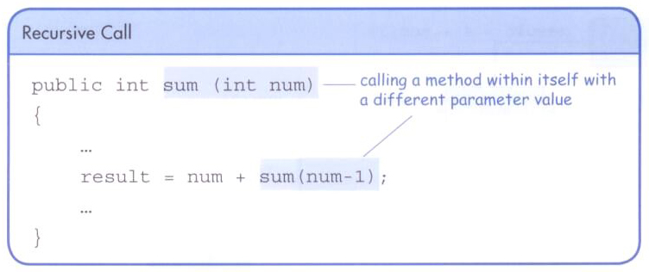
Recursive Programming
A recursive method that computes the sum of 1 to N:
public int sum(int num)
{
int result;
if (num == 1)
result = 1;
else
result = num + sum(num-1);
return result;
}

Slide 12
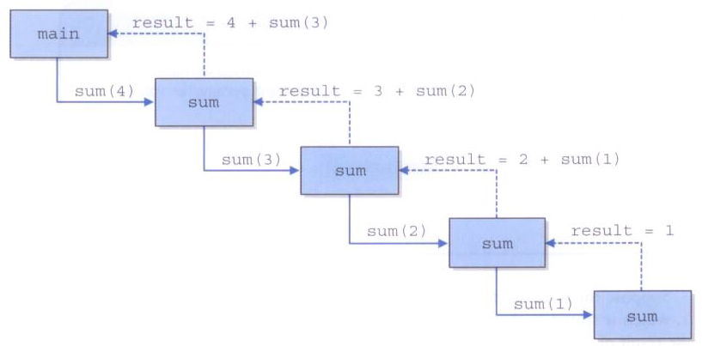
Recursive Programming
Tracing the recursive calls of the sum method

Slide 13
Recursion vs. Iteration
Just because we can use recursion to solve a problem, doesn't mean we should
For instance, we usually would not use recursion to solve the sum of 1 to N
The iterative version is easier to understand (in fact there is a formula that computes it without a loop at all)
You must be able to determine when recursion is the correct technique to use

Slide 14
Recursion vs. Iteration
Every recursive solution has a corresponding iterative solution
A recursive solution may simply be less efficient
Furthermore, recursion has the overhead of multiple method invocations
However, for some problems recursive solutions are often more simple and elegant to express

Slide 15
Direct vs. Indirect Recursion
A method invoking itself is considered to be direct recursion
A method could invoke another method, which invokes another, etc., until eventually the original method is invoked again
For example, method m1 could invoke m2, which invokes m3, which invokes m1 again
This is called indirect recursion
It is often more difficult to trace and debug

Slide 16
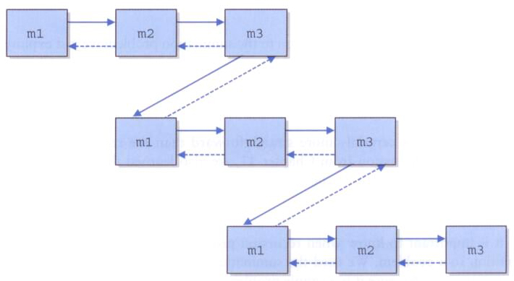
Direct vs. Indirect Recursion

Slide 17
Maze Traversal
We've seen a maze solved using a stack
The same approach can also be done using recursion
The run-time stack tracking method execution performs the same function
As before, we mark a location as "visited" and try to continue along the path
The base cases are:
a blocked path
finding a solution

Slide 18
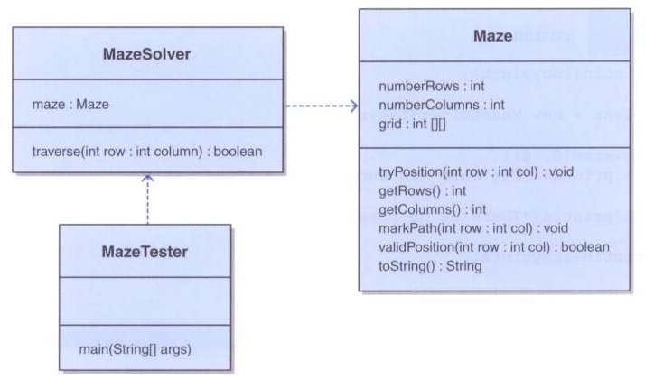
Maze Traversal

Slide 19
import java.util.*;
import java.io.*;
/**
* MazeTester uses recursion to determine if a maze can be traversed.
*
* @author Lewis and Chase
* @version 4.0
*/
public class MazeTester
{
/**
* Creates a new maze, prints its original form, attempts to
* solve it, and prints out its final form.
*/
public static void main(String[] args) throws FileNotFoundException
{
Scanner scan = new Scanner(System.in);
System.out.print("Enter the name of the file containing the maze: ");
String filename = scan.nextLine();
Maze labyrinth = new Maze(filename);
System.out.println(labyrinth);
MazeSolver solver = new MazeSolver(labyrinth);

Slide 20
if (solver.traverse(0, 0))
System.out.println("The maze was successfully traversed!");
else
System.out.println("There is no possible path.");
System.out.println(labyrinth);
}
}

Slide 21
import java.util.*;
import java.io.*;
/**
* Maze represents a maze of characters. The goal is to get from the
* top left corner to the bottom right, following a path of 1's. Arbitrary
* constants are used to represent locations in the maze that have been TRIED
* and that are part of the solution PATH.
*
* @author Lewis and Chase
* @version 4.0
*/
public class Maze
{
private static final int TRIED = 2;
private static final int PATH = 3;
private int numberRows, numberColumns;
private int[][] grid;

Slide 22
/**
* Constructor for the Maze class. Loads a maze from the given file.
* Throws a FileNotFoundException if the given file is not found.
*
* @param filename the name of the file to load
* @throws FileNotFoundException if the given file is not found
*/
public Maze(String filename) throws FileNotFoundException
{
Scanner scan = new Scanner(new File(filename));
numberRows = scan.nextInt();
numberColumns = scan.nextInt();
grid = new int[numberRows][numberColumns];
for (int i = 0; i < numberRows; i++)
for (int j = 0; j < numberColumns; j++)
grid[i][j] = scan.nextInt();
}
/**
* Marks the specified position in the maze as TRIED
*
* @param row the index of the row to try
* @param col the index of the column to try
*/
public void tryPosition(int row, int col)
{
grid[row][col] = TRIED;
}

Slide 23
/**
* Return the number of rows in this maze
*
* @return the number of rows in this maze
*/
public int getRows()
{
return grid.length;
}
/**
* Return the number of columns in this maze
*
* @return the number of columns in this maze
*/
public int getColumns()
{
return grid[0].length;
}
/**
* Marks a given position in the maze as part of the PATH
*
* @param row the index of the row to mark as part of the PATH
* @param col the index of the column to mark as part of the PATH
*/
public void markPath(int row, int col)
{
grid[row][col] = PATH;
}

Slide 24
/**
* Determines if a specific location is valid. A valid location
* is one that is on the grid, is not blocked, and has not been TRIED.
*
* @param row the row to be checked
* @param column the column to be checked
* @return true if the location is valid
*/
public boolean validPosition(int row, int column)
{
boolean result = false;
// check if cell is in the bounds of the matrix
if (row >= 0 && row < grid.length &&
column >= 0 && column < grid[row].length)
// check if cell is not blocked and not previously tried
if (grid[row][column] == 1)
result = true;
return result;
}

Slide 25
/**
* Returns the maze as a string.
*
* @return a string representation of the maze
*/
public String toString()
{
String result = "\n";
for (int row=0; row < grid.length; row++)
{
for (int column=0; column < grid[row].length; column++)
result += grid[row][column] + "";
result += "\n";
}
return result;
}
}

Slide 26
/**
* MazeSolver attempts to recursively traverse a Maze. The goal is to get from the
* given starting position to the bottom right, following a path of 1's. Arbitrary
* constants are used to represent locations in the maze that have been TRIED
* and that are part of the solution PATH.
*
* @author Lewis and Chase
* @version 4.0
*/
public class MazeSolver
{
private Maze maze;
/**
* Constructor for the MazeSolver class.
*/
public MazeSolver(Maze maze)
{
this.maze = maze;
}

Slide 27
/**
* Attempts to recursively traverse the maze. Inserts special
* characters indicating locations that have been TRIED and that
* eventually become part of the solution PATH.
*
* @param row row index of current location
* @param column column index of current location
* @return true if the maze has been solved
*/
public boolean traverse(int row, int column)
{
boolean done = false;
if (maze.validPosition(row, column))
{
maze.tryPosition(row, column); // mark this cell as tried
if (row == maze.getRows()-1 && column == maze.getColumns()-1)
done = true; // the maze is solved
else
{
done = traverse(row+1, column); // down
if (!done)
done = traverse(row, column+1); // right

Slide 28
if (!done)
done = traverse(row-1, column); // up
if (!done)
done = traverse(row, column-1); // left
}
if (done) // this location is part of the final path
maze.markPath(row, column);
}
return done;
}
}

Slide 29
The Towers of Hanoi
The Towers of Hanoi is a puzzle made up of three vertical pegs and several disks that slide onto the pegs
The disks are of varying size, initially placed on one peg with the largest disk on the bottom and increasingly smaller disks on top
The goal is to move all of the disks from one peg to another following these rules:
Only one disk can be moved at a time
A disk cannot be placed on top of a smaller disk
All disks must be on some peg (except for the one in transit)

Slide 30
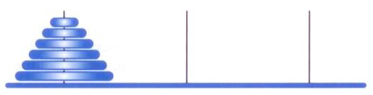
Towers of Hanoi
The initial state of the Towers of Hanoi puzzle:

Slide 31
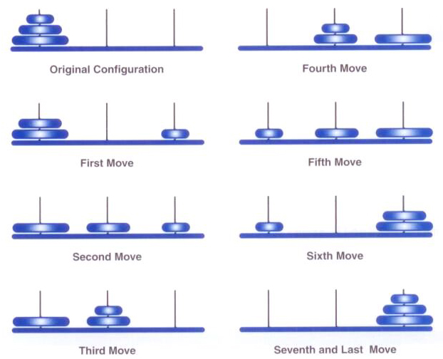
Towers of Hanoi
A solution to the three-disk Towers of Hanoi puzzle:

Slide 32
Towers of Hanoi
A solution to ToH can be expressed recursively
To move N disks from the original peg to the destination peg:
Move the topmost N-1 disks from the original peg to the extra peg
Move the largest disk from the original peg to the destination peg
Move the N-1 disks from the extra peg to the destination peg
The base case occurs when a peg contains only one disk

Slide 33
Towers of Hanoi
The number of moves increases exponentially as the number of disks increases
The recursive solution is simple and elegant to express and program, but is very inefficient
However, an iterative solution to this problem is much more complex to define and program

Slide 34
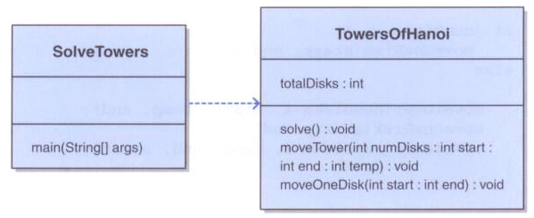
Towers of Hanoi

Slide 35
/**
* SolveTowers uses recursion to solve the Towers of Hanoi puzzle.
*
* @author Lewis and Chase
* @version 4.0
*/
public class SolveTowers
{
/**
* Creates a TowersOfHanoi puzzle and solves it.
*/
public static void main(String[] args)
{
TowersOfHanoi towers = new TowersOfHanoi(4);
towers.solve();
}
}

Slide 36
/**
* TowersOfHanoi represents the classic Towers of Hanoi puzzle.
*
* @author Lewis and Chase
* @version 4.0
*/
public class TowersOfHanoi
{
private int totalDisks;
/**
* Sets up the puzzle with the specified number of disks.
*
* @param disks the number of disks
*/
public TowersOfHanoi(int disks)
{
totalDisks = disks;
}
/**
* Performs the initial call to moveTower to solve the puzzle.
* Moves the disks from tower 1 to tower 3 using tower 2.
*/
public void solve()
{
moveTower(totalDisks, 1, 3, 2);
}

Slide 37
/**
* Moves the specified number of disks from one tower to another
* by moving a subtower of n-1 disks out of the way, moving one
* disk, then moving the subtower back. Base case of 1 disk.
*
* @param numDisks the number of disks to move
* @param start the starting tower
* @param end the ending tower
* @param temp the temporary tower
*/
private void moveTower(int numDisks, int start, int end, int temp)
{
if (numDisks == 1)
moveOneDisk(start, end);
else
{
moveTower(numDisks-1, start, temp, end);
moveOneDisk(start, end);
moveTower(numDisks-1, temp, end, start);
}
}

Slide 38
/**
* Prints instructions to move one disk from the specified start
* tower to the specified end tower.
*
* @param start the starting tower
* @param end the ending tower
*/
private void moveOneDisk(int start, int end)
{
System.out.println("Move one disk from " + start + " to " + end);
}
}

Slide 39
Analyzing Recursive Algorithms
To determine the order of a loop, we determined the order of the body of the loop multiplied by the number of loop executions
Similarly, to determine the order of a recursive method, we determine the the order of the body of the method multiplied by the number of times the recursive method is called
In our recursive solution to compute the sum of integers from 1 to N, the method is invoked N times and the method itself is O(1)
So the order of the overall solution is O(n)

Slide 40
Analyzing Recursive Algorithms
For the Towers of Hanoi puzzle, the step of moving one disk is O(1)
But each call results in calling itself twice more, so for N > 1, the growth function is
f(n) = 2^{n} – 1
This is exponential efficiency: O(2^{n})
As the number of disks increases, the number of required moves increases exponentially

